Slide 1
안드로이드 3주차
1901055 정시철

Slide 2
4가지 방법으로 JSON 받아오기 (홀수 학번)
기본적으로 프로그램에 적합한 xml과 Activity를 코딩한다.
Menu를 설정하고 JSON을 받아올 타입 별 메뉴 4가지를 설정한다.
기본적인 내부 프로그램(JAVA)만으로 JSON을 받아오는 프로그램을 작성한다. Byte화한 InputStream을 통해서 JSON을 코딩한다.
Raw를 이용해서 JSON을 받아온다. Raw 폴더 안에 hobby 파일을 집어넣는다.
Asset을 이용해서 JSON을 받아온다. 형식이 조금 다르지만 사실상 Raw와 방식은 유사하다. 데이터의 형식이 바뀌진 않기 때문에.
웹 서버는 위의 3가지 방식과 유사하지만, Web Server for Chrome이라는 사설 웹을 만들어서 JSON을 받아온다. 이 이후는 사실상 똑같다.

Slide 3
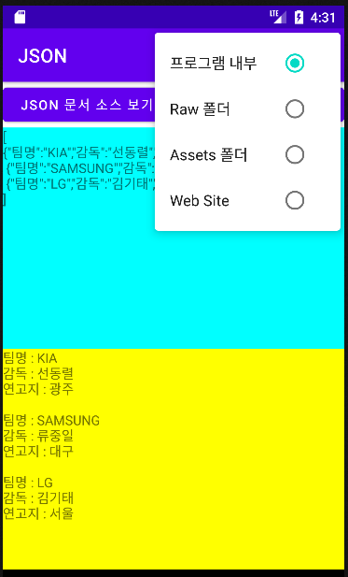
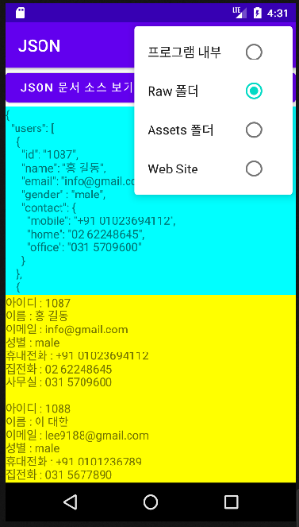
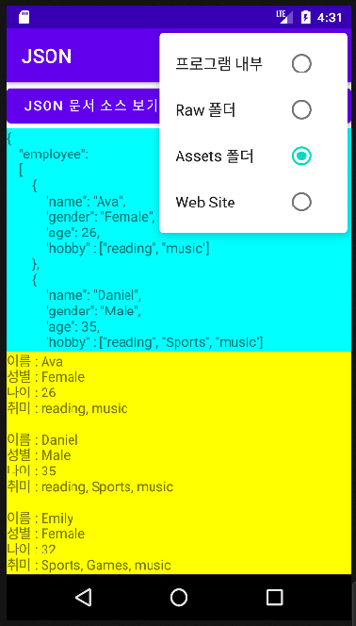
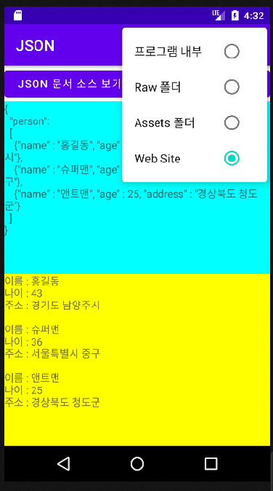
성공 화면

Slide 4
Main, Menu, Manifests XML 파일
<?xml version="1.0" encoding="utf-8"?> <LinearLayout xmlns:android="http://schemas.android.com/apk/res/android" xmlns:tools="http://schemas.android.com/tools" android:layout_width="match_parent" android:layout_height="match_parent" android:orientation="vertical" tools:context=".MainActivity"> <LinearLayout android:layout_width="match_parent" android:layout_height="wrap_content"> <Button android:id="@+id/button1" android:layout_width="0dp" android:layout_height="wrap_content" android:layout_weight="1" android:text="JSON 문서 소스 보기"/> <Button android:id="@+id/button2" android:layout_width="0dp" android:layout_height="wrap_content" android:layout_marginLeft="5dp" android:layout_weight="1" android:text="JSON Parser"/> </LinearLayout> <LinearLayout android:layout_width="match_parent" android:layout_height="match_parent" android:orientation="vertical"> <ScrollView android:layout_width="match_parent" android:layout_height="0dp" android:layout_weight="1" android:background="#00ffff"> <TextView android:id="@+id/textView1" android:layout_width="wrap_content" android:layout_height="wrap_content" android:text="Hello World!"/> </ScrollView> <ScrollView android:layout_width="match_parent" android:layout_height="0dp" android:background="#ffff00" android:layout_weight="1"> <TextView android:id="@+id/textView2" android:layout_width="wrap_content" android:layout_height="wrap_content" android:text="Hello World!"/> </ScrollView> </LinearLayout> </LinearLayout>
<?xml version="1.0" encoding="utf-8"?> <menu xmlns:android="http://schemas.android.com/apk/res/android"> <group android:checkableBehavior="single"> <item android:id="@+id/item1" android:checked="true" android:title="프로그램 내부" /> <item android:id="@+id/item2" android:title="Raw 폴더" /> <item android:id="@+id/item3" android:title="Assets 폴더" /> <item android:id="@+id/item4" android:title="Web Site" /> </group> </menu>
메뉴
메인
<?xml version="1.0" encoding="utf-8"?> <manifest xmlns:android="http://schemas.android.com/apk/res/android" xmlns:tools="http://schemas.android.com/tools"> <uses-permission android:name="android.permission.INTERNET"/> <application android:allowBackup="true" android:usesCleartextTraffic="true" android:dataExtractionRules="@xml/data_extraction_rules" android:fullBackupContent="@xml/backup_rules" android:icon="@mipmap/ic_launcher" android:label="@string/app_name" android:supportsRtl="true" android:theme="@style/Theme.JSON" tools:targetApi="31"> <activity android:name=".MainActivity" android:exported="true"> <intent-filter> <action android:name="android.intent.action.MAIN" /> <category android:name="android.intent.category.LAUNCHER" /> </intent-filter> </activity> </application> </manifest>
매니페스트

Slide 5
메인 액티비티 코드, Import 선언
public class MainActivity extends AppCompatActivity { TextView textView; TextView textView1; int type = 1; String json = ""; String page = "http://10.50.192.25:8887/member.JSON"; @Override protected void onCreate(Bundle savedInstanceState) { super.onCreate(savedInstanceState); setContentView(R.layout.activity_main); textView = findViewById(R.id.textView1); textView1 = findViewById(R.id.textView2); Button button1 = findViewById(R.id.button1); button1.setOnClickListener(new View.OnClickListener() { @Override public void onClick(View v) { InputStream inputStream = null; if (type == 1) { String input = "[\n" + "{\"팀명\":\"KIA\",\"감독\":\"선동렬\",\"연고지\":\"광주\"}," + "\n {\"팀명\":\"SAMSUNG\",\"감독\":\"류중일\",\"연고지\":\"대구\"}," + "\n {\"팀명\":\"LG\",\"감독\":\"김기태\",\"연고지\":\"서울\"}"+ "\n]"; inputStream = new ByteArrayInputStream(input.getBytes()); try { byte[] txt = new byte[inputStream.available()]; inputStream.read(txt); json = new String(txt); textView.setText(json); inputStream.close(); } catch (IOException e) { Toast.makeText(MainActivity.this, e.getMessage(), Toast.LENGTH_SHORT).show(); } } else if (type == 2) { inputStream = getResources().openRawResource(R.raw.sub_info); try { byte[] txt = new byte[inputStream.available()]; inputStream.read(txt); json = new String(txt); textView.setText(json); inputStream.close(); } catch (IOException e) { Toast.makeText(MainActivity.this, e.getMessage(), Toast.LENGTH_SHORT).show(); } } else if (type == 3) { try { inputStream = getAssets().open("hobby.json"); byte[] txt = new byte[inputStream.available()]; inputStream.read(txt); json = new String(txt); textView.setText(json); inputStream.close(); } catch (IOException e) { Toast.makeText(MainActivity.this, e.getMessage(), Toast.LENGTH_SHORT).show(); } } else { JSONThread thread = new JSONThread(MainActivity.this, page); thread.start(); try { thread.join(); json = thread.getJson(); textView.setText(json); } catch (InterruptedException e) { Toast.makeText(MainActivity.this, e.getMessage(), Toast.LENGTH_SHORT).show(); } } } });
Button button2 = findViewById(R.id.button2); button2.setOnClickListener(new View.OnClickListener() { @Override public void onClick(View v) { textView1.setText(""); if (json.equals("")) { Toast.makeText(MainActivity.this, "먼저 JSON 문서 받으세요", Toast.LENGTH_SHORT).show(); } else { if (type == 1) { try { JSONArray jsonArray = new JSONArray(json); for (int i = 0; i < jsonArray.length(); i++) { JSONObject object = jsonArray.getJSONObject(i); String team = object.getString("팀명"); String dir = object.getString("감독"); String address = object.getString("연고지"); textView1.append("팀명 : " + team + "\n"); textView1.append("감독 : " + dir + "\n"); textView1.append("연고지 : " + address + "\n\n"); } } catch (JSONException e) { Toast.makeText(MainActivity.this, e.getMessage(), Toast.LENGTH_SHORT).show(); } }else if (type == 2) { try { JSONObject root = new JSONObject(json); JSONArray array = root.getJSONArray((String) root.names().get(0)); for (int i = 0; i < array.length(); i++) { JSONObject object = array.getJSONObject(i); String id = object.getString((String) object.names().get(0)); String name = object.getString((String) object.names().get(1)); String email = object.getString((String) object.names().get(2)); String gender = object.getString((String) object.names().get(3)); JSONObject contact = object.getJSONObject("contact"); String mobile = contact.getString("mobile"); String home = contact.getString("home"); String office = contact.getString("office"); textView1.append("아이디 : " + id + "\n"); textView1.append("이름 : " + name + "\n"); textView1.append("이메일 : " + email + "\n"); textView1.append("성별 : " + gender + "\n"); textView1.append("휴대전화 : " + mobile + "\n"); textView1.append("집전화 : " + home + "\n"); textView1.append("사무실 : " + office + "\n\n"); } } catch (JSONException e) { Toast.makeText(MainActivity.this, e.getMessage(), Toast.LENGTH_SHORT).show(); } } else if (type == 3) { try { JSONObject root = new JSONObject(json); JSONArray array = root.getJSONArray((String) root.names().get(0)); for (int i = 0; i < array.length(); i++) { JSONObject object = array.getJSONObject(i); String name = object.getString((String) object.names().get(0)); String gender = object.getString((String) object.names().get(1)); int age = object.getInt((String) object.names().get(2)); JSONArray arrays = object.getJSONArray((String) object.names().get(3)); String temp = ""; for (int j = 0; j < arrays.length(); j++) { temp += arrays.getString(j) +", "; } temp = temp.substring(0, temp.length() - 2); textView1.append("이름 : " + name + "\n"); textView1.append("성별 : " + gender + "\n"); textView1.append("나이 : " + age + "\n"); textView1.append("취미 : " + temp + "\n\n"); } } catch (JSONException e) { Toast.makeText(MainActivity.this, e.getMessage(), Toast.LENGTH_SHORT).show(); } } else { try { JSONObject root = new JSONObject(json); JSONArray array = root.getJSONArray((String) root.names().get(0)); for (int i = 0; i < array.length(); i++) { JSONObject object = array.getJSONObject(i); String name = object.getString((String) object.names().get(0)); int age = object.getInt((String) object.names().get(1)); String address = object.getString((String) object.names().get(2)); textView1.append("이름 : " + name + "\n"); textView1.append("나이 : " + age + "\n"); textView1.append("주소 : " + address + "\n\n"); } } catch (JSONException e) { Toast.makeText(MainActivity.this, e.getMessage(), Toast.LENGTH_SHORT).show(); } } } } });
} @Override public boolean onCreateOptionsMenu(Menu menu) { MenuInflater inflater = getMenuInflater(); inflater.inflate(R.menu.menu, menu); return true; } @Override public boolean onOptionsItemSelected(@NonNull MenuItem item) { switch (item.getItemId()) { case R.id.item1: type = 1; break; case R.id.item2: type = 2; break; case R.id.item3: type = 3; break; case R.id.item4: type = 4; } item.setChecked(true); return true; } }
Package com.example.json; import androidx.annotation.NonNull; import androidx.appcompat.app.AppCompatActivity; import android.os.Bundle; import android.view.Menu; import android.view.MenuInflater; import android.view.MenuItem; import android.view.View; import android.widget.Button; import android.widget.TextView; import android.widget.Toast; import org.json.JSONArray; import org.json.JSONException; import org.json.JSONObject; import java.io.ByteArrayInputStream; import java.io.IOException; import java.io.InputStream;
코드가 너무 길어서 분할했습니다.

Slide 6
JSONThread 코드
public class JSONThread extends Thread{ private Context context; private String page; private Handler handler = new Handler(); private String json = ""; public JSONThread(Context context, String page) { this.context = context; this.page = page; } @Override public void run() { HttpURLConnection connection = null; InputStream inputStream = null; InputStreamReader streamReader = null; BufferedReader reader = null; try { URL url = new URL(page); connection = (HttpURLConnection) url.openConnection(); inputStream = connection.getInputStream(); streamReader = new InputStreamReader(inputStream, StandardCharsets.UTF_8); reader = new BufferedReader(streamReader); String line; while ((line = reader.readLine()) != null) json += line + "\n"; } catch (IOException e) { handler.post(new Runnable() { @Override public void run() { Toast.makeText(context, e.getMessage(), Toast.LENGTH_SHORT).show(); } }); } finally { try { reader.close(); streamReader.close(); inputStream.close(); connection.disconnect(); } catch (IOException e) { handler.post(new Runnable() { @Override public void run() { Toast.makeText(context, e.getMessage(), Toast.LENGTH_SHORT).show(); } }); } } } public String getJson() { return json; } }
package com.example.json; import android.content.Context; import android.os.Handler; import android.widget.Toast; import java.io.BufferedReader; import java.io.IOException; import java.io.InputStream; import java.io.InputStreamReader; import java.net.HttpURLConnection; import java.net.MalformedURLException; import java.net.URL; import java.nio.charset.StandardCharsets;

